Slide 1
Synchronization in Thread
Rajasekaran S
Assistant Professor,
Department of Information Technology,
KGiSL Institute of Technology,
email: proffraja@gmail.com
Github:www.github.com/rajasekaranap

Slide 2
Synchronization in Thread
Multi-threaded programs may often come to a situation where multiple threads try to access the same resources and finally produce erroneous and unforeseen results.
This is known as problem of synchronization we need take care and impose some regulation for accessing shared resource.
This situation is referred to race condition.

Slide 3
Ways to Synchronization in Java
In java synchronization is a block of code that uses the shared resources [critical part] is declared as synchronized and only one thread is allowed to access at a time.
Monitor monitors the shared resource.
If a thread need to access a shared resource first it must acquire a lock.
Then proceed to critical block execution.
Then releases the lock and allows other thread to acquire a lock .

Slide 4
Types of Synchronization
Mutual Exclusion
Synchronized Methods.
Synchronized Block.
Static Synchronization.
Cooperation
Inter thread communication

Slide 5
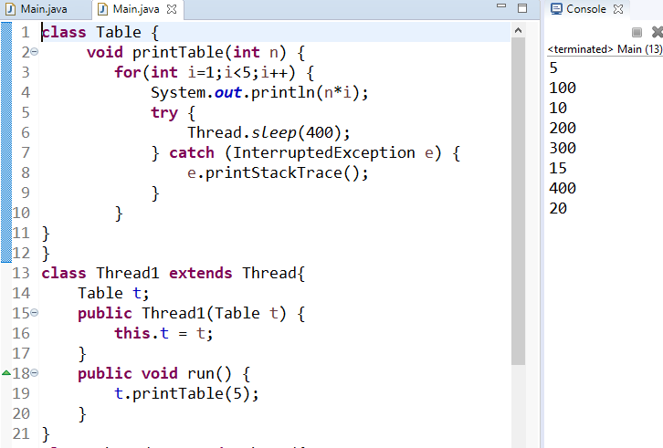
Process without Synchronization

Slide 6
Non Synchronized Table Printing
Printing5th Table
run()
shared
Table
Main
printTable()
main()
shared
Printing100th Table
Non synchronized
run()

Slide 7
Synchronized Method
A method that is shared among the threads need’s to be declared as synchronized.
Syntax
Synchronized return_type method_name(args){
//block of code
}

Slide 8
Cooperative Threads
Two threads responsible for completing one process.
Two threads must co-operate with each other to avoid race conditions.
Inter thread communication is a key to achieve this.
Eg:
Producer Consumer Problem [Bounded Buffer Problem]

Slide 9
Producer Consumer Problem [Bounded Buffer Problem]
Here producer produces element’s and stored in buffer [it is bounded or has limit for no of elements to be stored].
Consumer consumes the elements produced by producer and removes the elements from the buffer.
This process till continues as long as produces puts the element on time and consumer consumes elements on time.

Slide 10
Producer Consumer Problem [Bounded Buffer Problem]
In reality producer may cause some delay to produce in that situation if buffer is empty then consumer must wait.
Some times consumer may cause delay to consume the elements in that case if buffer is full then producer must wait.

Slide 11
Without Communication
There is no element to consume
1
2
PRODUCER
CONSUMER

Slide 12
Producer Produces
1
Wait
PRODUCER
CONSUMER
1
2
Wait
PRODUCER
CONSUMER
1
2
3
Wait
PRODUCER
CONSUMER
1
2
3
4
Wait
PRODUCER
CONSUMER

Slide 13
Consumer Consumes
Wait
1
2
3
4
PRODUCER
CONSUMER
Wait
2
3
4
PRODUCER
CONSUMER
Wait
3
4
PRODUCER
CONSUMER
Wait
4
PRODUCER
CONSUMER

Slide 14
Demo
https://github.com/rajasekaranap/CS8392-Workspace/tree/master/U4-ProduserConsumerWithSync

Slide 15
Demon Thread
Daemon thread in java is a service provider thread that provides services to the user thread.
It provides services to user threads for background supporting tasks. It has no role in life than to serve user threads.
Its life depends on user threads.
It is a low priority thread.

Slide 16
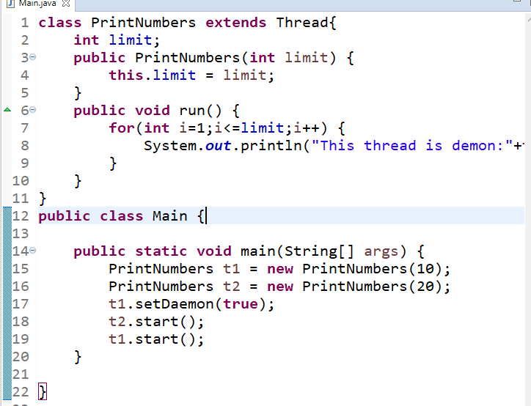
Demon Thread Demo

Slide 17
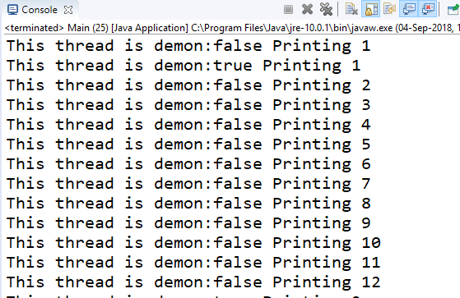
Output

Slide 18
Thank You
Rajasekaran S
Assistant Professor,
Department of Information Technology,
KGiSL Institute of Technology,
email: proffraja@gmail.com
Github:www.github.com/rajasekaranap

